Slide 1
Human Abilities: Motor and Cognitive Assistive Technology and Laws
Matt Huenerfauth, 2016
This material is based upon work supported by National Science Foundation award number 1540396.
In the process of creating this new presentation, small quantities of images and factual material have been included from other sources for the purpose of display during face-to-face teaching.

Slide 2
Outline
Senses (last time)
Motor System
Cognitive Abilities
How do People with Disabilities Access Computers and the Web?
Legal Requirements for Accessibility of Software and Websites

Slide 3
Motor Impairments

Slide 4
Forms of Movement Impairments
Various forms of physical disability from a diversity of causes.
Can be difficulty to generalize.
Paralysis.
Muscle control, dexterity, strength, etc.
Control of the speech and vocal organs.
Seizure disorders.

Slide 5
Some Types of Motor Impairments
Cerebral Palsy
Spina Bifida
Spinal Cord Injury
Multiple Sclerosis
Muscular Dystrophy
Seizure Disorders
Brain Injuries
The specific medical conditions that lead to motor impairments are less useful for HCI professionals to consider than the practical impact on the person’s capabilities… (See next several slides)

Slide 6
Capabilities Considerations (1)
Can use both hands?
Get tired quickly? Need strength for task?
Fine control? (Computer mouse? Buttons?)
Large movements difficult? Far apart objects?
Spastic/jumpy/uncontrolled movements?
Movements too slow to complete task?
Can use only one hand?
Same as above…
Need to press/hold two things at once?
Some tasks/tools designed for two hands…

Slide 7
Capabilities Considerations (2)
Upper body movement?
Handles? Controls? Signals?
Picking up objects? Holding small/big objects?
Manipulate money? Buttons?
Head movement?
Can turn gaze to look?
Wheelchair use?
Manual, power (controls?)

Slide 8
Capabilities Considerations (3)
Standing
Without assistance, with crutches/handrails?
Get up? Sit down? Need assistance?
For how long (strength, fatigue)?
Balance considerations? Moving vehicle?
Walking
Without assistance, with crutches/handrails?
For what distance? For how long? How fast?
Steps (how many? How high?)? Inclines?
Moving through crowds? Uneven terrain? Balance?

Slide 9
Outline
Senses (last time)
Motor System
Cognitive Abilities
How do People with Disabilities Access Computers and the Web?
Legal Requirements for Accessibility of Software and Websites

Slide 10
Variations in Cognitive Abilities

Slide 11
Individual Cognitive Differences
long term – personality, physical and intellectual abilities
short term – effect of stress or fatigue
changing – age

Slide 12
Cognitive/Learning Impairments
There is great diversity here…
Impairments in attention, long term memory (episodic vs. semantic memory, recognition vs. recall), short term memory, perceptual memory, perceptual processing (basic visual and audio perceptions)
Language impairments: aphasias
Developmental Disabilities, including intellectual disabilities (mental retardation) or Autism
Learning disabilities: dyslexia, dyscalculia, etc.
Dementia

Slide 13
Effects of aging on cognition
Older adults perform less well in
Tasks that require attention to be divided
Speech recognition and speech discrimination
Some memory tasks
However, these differences also depend on
Intelligence
Health
Years of formal education
Expertise

Slide 14
Brain injury or stroke may affect cognitive skills
Cognition
Remember, recall info
Building new coping skills
Speech and Language
Slurred, labored speech
Difficulty selecting words or constructing sentences
Social & behavioral aspects
Personality
Temperament
General behavior
Neuromotor and physical disabilities
Poor eye-hand coordination
Vision impairment
Hearing impairment
Physical functioning
Balance
Locomotion
Stamina

Slide 15
Learning Disabilities
5 percent to 10 percent of the school age population
Can occur at all levels of intelligence
Dyslexia and other reading/writing problems
Word knowledge and recognition, letter patterns
Writing and spelling problems
Dyscalculia and difficulties with math and numbers
Counting, Writing numbers, basic math concepts
Attention deficit disorder: focusing and completing tasks
Some students also exhibit hyperactive behavior

Slide 16
Developmental Disabilities
This includes intellectual disabilities (mental retardation) and other cognitive and motor impairments, which start early in life
The brain is organized and functions differently
Multiple biological causes
Prevalence: Approximately 1% of children
This category also includes Autism, which is a spectrum of disorders based on difficulty with social relationships, communication, and change or repetitive behaviors

Slide 17
Co-existence of Developmental Disabilities
Many developmental disabilities may co-occur, e.g., Autism and Intellectual Disability, illustrated below:
Person with Mild Autism
Social and Behavioral Difficulties
Minimally Affected Adaptation
Person with Intellectual Disability
Lack verbal skills
Poor academic skills
Person with Average or Above Average IQ
Verbal
Good academic skills
Person with Severe Autism
Social and Behavioral Difficulties
Severely Affected Adaptation

Slide 18
Outline
Senses (last time)
Motor System
Cognitive Abilities
How do People with Disabilities Access Computers and the Web?
Legal Requirements for Accessibility of Software and Websites

Slide 19
How Do People with Disabilities Access the Web?

Slide 20
Blind Users: Screen Readers
Software that converts text into synthesized speech so blind people can listen to web content or other text on a computer.
It does more than just read the screen:
It has to "read" the toolbars, menus, etc.
Provides keyboard-based controls of computer. Blind users generally do not use the “mouse” or trackpad.
It has to decide the sequence in which to read a webpage.
Sometime webpages are difficult to linearize or don't make sense when you do. Some webpages don't include any logical headings and sub-headings; so, you have to listen to the whole thing without being able to skip ahead.
Windows: JAWS ($4000). Mac: VoiceOver (built-in).

Slide 21
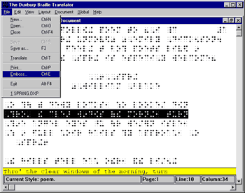
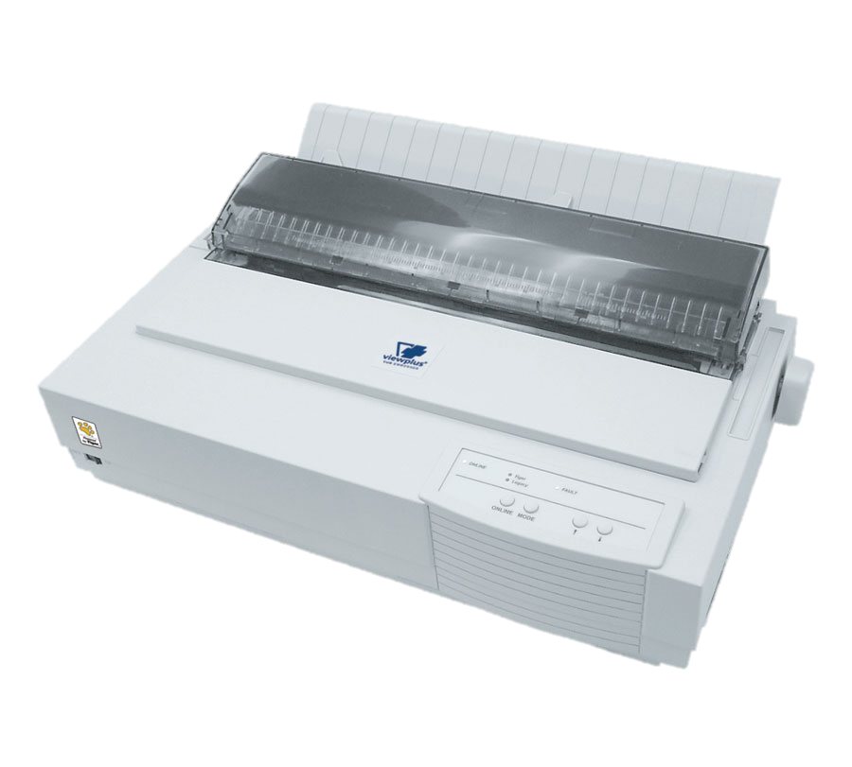
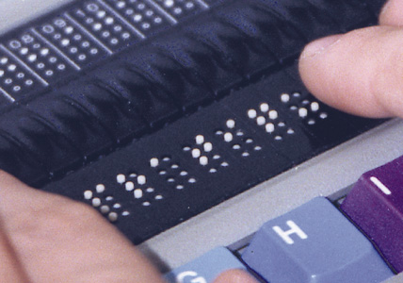
Braille Technology
System of raised dots to represent letters, groups of letters, or other symbols (math)
Electronic “refreshable” Braille display (the words update as the person’s finger reaches the end of the line of text). Can be used as “output” for a screen reader software, to enable silent use.
Text to Braille software
Braille “printer” (creates bumpy cardboard)

Slide 22
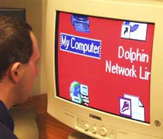
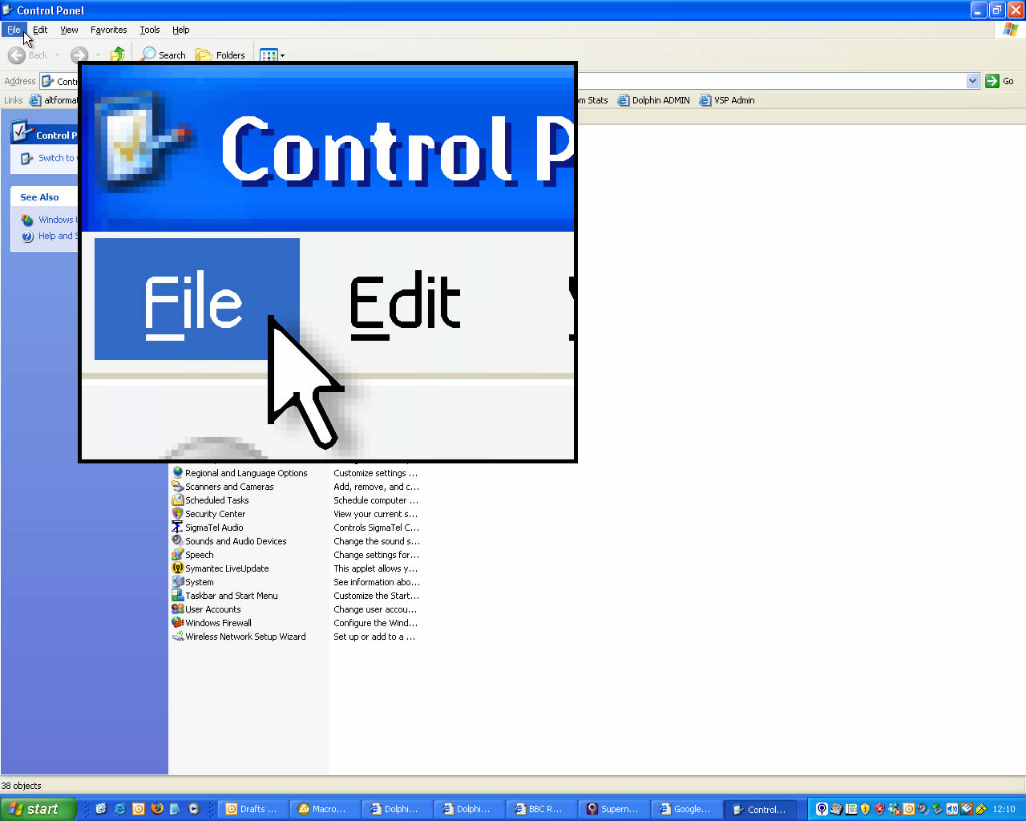
Low Vision: Screen Magnification Software
Enlarge page
Smooth fonts
Split screen or enlarge area under mouse
Changes colors
These users prefer pages with narrow columns or re-wrap-able text.
Many also prefer webpages that allow colors or font sizes to be changed.

Slide 23
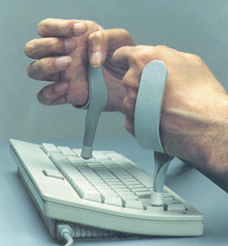
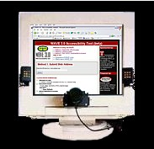
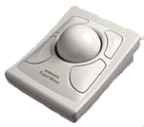
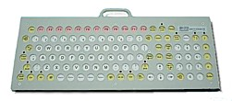
Motor Disabilities: Input Methods
Eye tracker
Typing speed can be very slow.
Using a mouse can be very difficult; so, many of these users prefer to interact with their computers using keyboards only (or they might use alternative “pointer” control methods like trackballs or eye-trackers).
Trackball
Palm sticks
Mouth stick
Raised edge keyboard

Slide 24
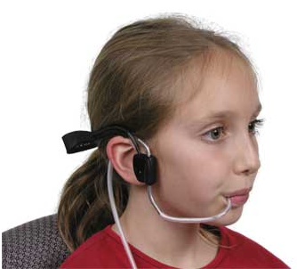
Motor Disabilities: Row/Column Entry
A
A
A
A
A
A
A
A
A
B
B
B
B
B
B
B
B
B
C
C
C
C
C
C
C
C
C
D
D
D
D
D
D
D
D
D
E
E
E
E
E
E
E
E
E
F
F
F
F
F
F
F
F
F
G
G
G
G
G
G
G
G
G
H
H
H
H
H
H
H
H
H
I
I
I
I
I
I
I
I
I
J
J
J
J
J
J
J
J
J
K
K
K
K
K
K
K
K
K
L
L
L
L
L
L
L
L
Button switch
L
M
M
M
M
M
M
M
M
M
N
N
N
N
N
N
N
N
N
O
O
O
O
O
O
O
O
O
P
P
P
P
P
P
P
P
P
Q
Q
Q
Q
Q
Q
Q
Q
Q
R
R
R
R
R
R
R
R
R
S
S
S
S
S
S
S
S
S
T
T
T
T
T
T
T
T
T
U
U
U
U
U
U
U
U
U
V
V
V
V
V
V
V
V
V
W
W
W
W
W
W
W
W
W
X
X
X
X
X
X
X
X
X
Y
Y
Y
Y
Y
Y
Y
Y
Y
Z
Z
Z
Z
Z
Z
Z
Z
Z
_
_
_
_
_
_
_
_
_
,
,
,
,
,
,
,
,
,
.
.
.
.
.
.
.
.
.
#
#
#
#
#
#
#
#
#
Scanning Keyboard
(virtual keyboard)
Sometimes these keyboards also include up, down, left, right, tab, and ENTER keys.
Sip/puff switch
⬆
⬇
⬅
➔

Slide 25
View This Video at Home: “Access to Technology in the Workplace: In Our Own Words”
13 Minutes
Professionally
Captioned
Audio Descriptions of Visual Details
https://youtu.be/al6ySNNCrhM

Slide 26
Outline
Senses (last time)
Motor System
Cognitive Abilities
How do People with Disabilities Access Computers and the Web?
Legal Requirements for Accessibility of Software and Websites

Slide 27
Laws, Legal Requirements

Slide 28
Vocational Rehabilitation Act
1973
The VR Act prohibits discrimination on the basis of disability in programs conducted by Federal agencies, in programs receiving Federal financial assistance, in Federal employment, and in the employment practices of Federal contractors.
Sections 501 and 503 address employment non-discrimination
The standards for determining employment discrimination under the Rehabilitation Act are the same as those used in the Americans with Disabilities Act (we’ll discuss the ADA later).
Section 504 addresses the accessibility of government funded programs.
Section 508 addresses the accessibility of information technology used by federal agencies.

Slide 29
Vocational Rehabilitation Act
1973
Section 504 of the Act:
“No qualified individual with a disability in the United States shall be excluded from, denied the benefits of, or be subjected to discrimination under” any program or activity that either receives Federal financial assistance or is conducted by any Executive agency or the United States Postal Service.
Details discussed in the law:
reasonable accommodation for employees with disabilities
program accessibility
effective communication with people with hearing or vision disabilities
accessible new construction and alterations of buildings
What if the government-funded agency delivers its services with the aid of software or websites that people use? They need to be accessible!

Slide 30
Vocational Rehabilitation Act
1973
Section 508 of the Act:
Section 508 establishes requirements for electronic and information technology developed, maintained, procured, or used by the Federal government. Section 508 requires Federal electronic and information technology to be accessible to people with disabilities, including employees and members of the public.
An accessible IT system is one that can be operated in a variety of ways and does not rely on a single sense or ability of the user.
Some individuals need accessibility-related software or peripheral devices in order to use systems that comply with Section 508. So, the IT doesn’t need to be accessible in a stand-alone manner, but it does need to be very compatible with the standard assistive technology tools that people with disabilities use.
Do you think companies will develop a special version of all of their software products in order to sell them to the government and then use their non-accessible version for everyone else? No: This law caused lots of software to be accessible for various customers.

Slide 31
Americans with Disabilities Act (ADA)
1990
Goal: prevent discrimination on basis of disability in employment, programs and services provided by state and local governments, goods and services provided by public companies, and commercial facilities.
Fair and level playing field.
“Disability” = Physical or mental impairment that substantially limits an individual in a major life activity
There’s no exclusive list of specific impairments covered by ADA
ADA mandates protections for people with disabilities in public and private sector employment, all public services, and public accommodations, transportation, and telecommunications.

Slide 32
ADA: Telecommunications
Telephone and television access for people with hearing and speech disabilities.
Common carriers (telephone companies) must establish interstate and intrastate telecommunications relay services (TRS) 24 hours a day, 7 days a week.
TRS enables callers with hearing and speech disabilities who use telecommunications devices for the deaf (TDDs), also known as teletypewriters (TTYs), and callers who use voice telephones to communicate with each other via a third party communications assistant.
ADA also requires closed captioning of Federally funded public service announcements.

Slide 33
ADA: Public Accommodations
Some businesses & nonprofits are public accommodations:
Privately operated entities offering certain courses and examinations, transportation, and/or commercial facilities.
Private entities who own, lease, lease to, or operate facilities such as restaurants, retail stores, hotels, movie theaters, private schools, convention centers, doctors' offices, homeless shelters, transportation depots, zoos, funeral homes, day care centers, and recreation facilities including sports stadiums and fitness clubs.
Must not exclude, segregate, or give unequal treatment.
Architectural standards for new and altered buildings
Reasonable modifications to policies, practices, and procedures
Communication with people with hearing, vision, or speech disabilities
Remove barriers in existing buildings where it is easy to do so without much difficulty or expense, given their resources.
If these businesses or nonprofits provide services via the web, then their website must be accessible, too.

Slide 34
Outline
Senses (last time)
Motor System
Cognitive Abilities
How do People with Disabilities Access Computers and the Web?
Legal Requirements for Accessibility of Software and Websites

Slide 35
EXTRA SLIDES
Dyslexia Simulation

Slide 36
Dyslexia

Slide 37
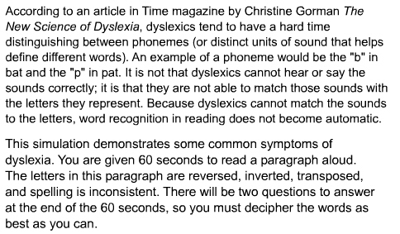
Dyslexia Simulation

Slide 38
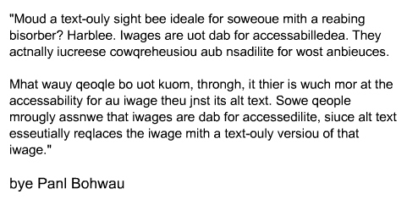

Slide 39
Questions
Why are images good for web accessibility?
Who would be negatively impacted by a text-only website?

Slide 40
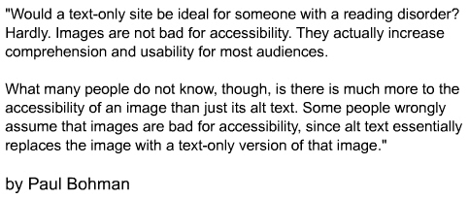
Unmodified Paragraph
Even if you were able to “decode” the text in order to read it, the amount of effort necessary to perform that “decoding” detracted from the attention you could devote to gaining knowledge form the text and remembering it.

