Slide 1
Human Abilities:
Senses

Slide 2
Outline - Vision
Senses
  Vision
  Hearing
  Touch
  Smell
Motor System
Cognitive Abilities

Slide 3
Human Vision 101
Visual resolution

Slide 4
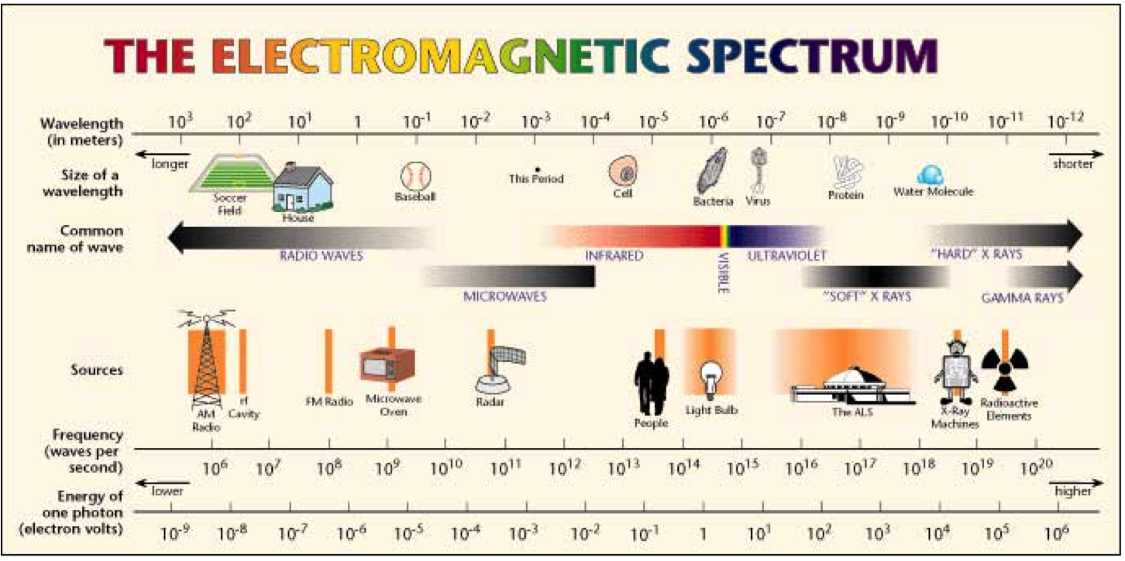
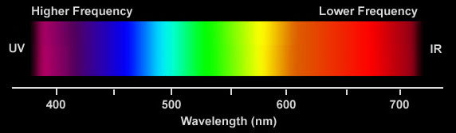
The electromagnetic spectrum
Light can be described in frequency (above) or wavelengths (left).
Reds have longer wavelengths and lower frequencies.

Slide 5
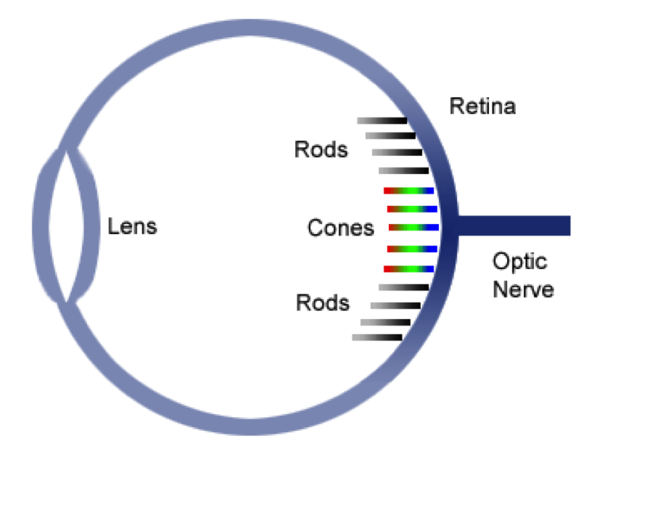
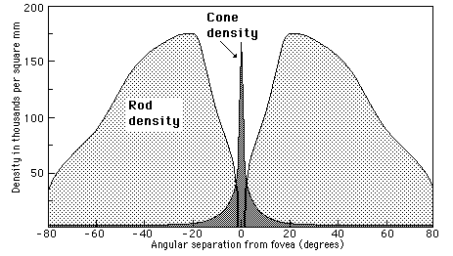
Rods and Cones
Rods: best at detecting brightness; we
depend on them in low-light conditions
Cones: three different types, which respond
to different wavelengths of light

Slide 6
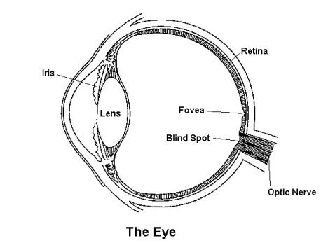
Physiology
Fovea: Center of visual field on retina, high resolution vision

Slide 7
Visual Impairments - Resolution and Clarity

Slide 8
Definitions, Prevalence
Definitions used in some U.S. laws:
“Blindness”
Visual acuity of 20/200 or worse in the best eye with best correction, or a visual field of 20 percent or less
“Partial sight (low vision)”
Visual acuity greater than 20/200 but not greater than 20/70 in the best eye after correction
How common is this?
5% of American children (and 20% of people over age 65) have a serious eye disorder.

Slide 9
Examples of
Low-Vision Conditions
Macular Degeneration
Glaucoma
Diabetic Retinopathy
Cataracts

Slide 10
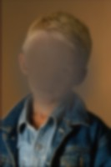
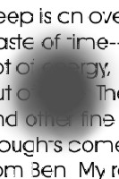
Macular Degeneration
Gradual thinning or sudden damage (leaking blood vessel) of the macula, which is at the center of the retina, at the back of the eye. Loss of central vision.
Notes:
The macula is near the center of the retina, which is the area in the back of the eye.
The aging process and the thinning of the tissues of the macula cause the most common form of macular degeneration,"dry" macular degeneration. The result is a gradual loss of vision.
"Wet" macular degeneration occurs when abnormal blood vessels at the back of the eye begin to leak fluid or blood and blur central vision, often resulting in rapid loss of vision.
The person's central area of sight is affected the most, making it difficult to see objects that the person is looking at directly.

Slide 11
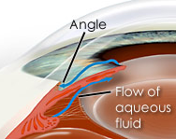
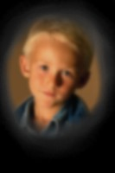
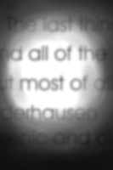
Glaucoma
Increase in pressure of the fluids inside the eye, due to a
problem with the drainage structures at edge of iris.
Loss of peripheral vision, blurring of central vision.
Notes:
Glaucoma is caused by an increase in pressure inside the eye, which causes damage to the optic nerve.
The end result is often the opposite of the effect of macular degeneration: the loss of peripheral vision and a blurry central area of vision. It can be particularly difficult to read text because text seems faded as well as blurry.
Some people have compared the effects of glaucoma to looking at everything through a straw.
The angle is the area in the anterior chamber where the cornea and iris join. It makes up the eye's drainage system and is comprised of outermost part of the iris, the front of the ciliary body, the trabecular meshwork, and the Canal of Schlemm.

Slide 12
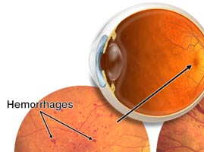
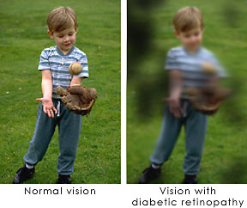
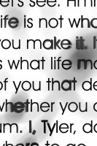
Diabetic Retinopathy
One of the effects of long-term diabetes can be
the leaking of retinal blood vessels, causing dark
patches in the field of vision where the leaks occur.
Notes:
One of the effects of long-term diabetes can be the leaking of retinal blood vessels, causing dark patches in the field of vision where the leaks occur. Text can appear blurred or distorted in these regions.

Slide 13
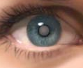
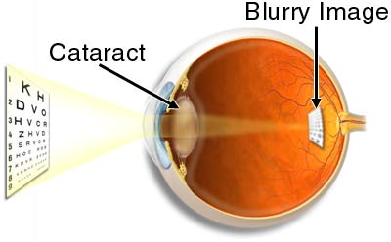
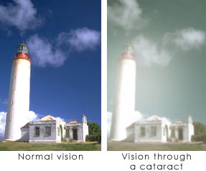

Cataracts
Areas of opacity in the lens,
causes blurred or hazy effect.
It’s worse in bright light.
Notes:
Individuals with cataracts have areas of opacity in the lens of their eyes which results in a blurred or hazy effect, especially in bright light.
Text can appear to fade into the background.
High contrast is especially important for people with advanced cataracts.

Slide 14
Other Causes of Vision Impairments
Genetically Determined
  Albinism (lack of pigment, needed in the eye)
  Retinitis pigmentosa
  Optic atrophy
  Cataracts
  Severe myopia associated with retinal detachment
  Lesions of the cornea
  Abnormalities of the iris
  Microphthalmia
  Anophthalmia
  Buphthalmos (Glaucoma)
Acquired Disorders
  Exposure to drugs
  Radiation
  Prenatal infections
  Diseases
  Xeropthalmia
  Prolonged use of oxygen with premature infants
  Cortical visual impairment
  Trachoma
  Macular degeneration

Slide 15
Visual Impairments - Age-Related Vision Loss

Slide 16
Age-Related Vision Impairment
More likely for an older adult to have some kind of vision impairment, e.g., lens abnormalities:
  Myopia/near-sightedness
  Presbyopia/far-sightedness
Leading age-related cause of vision loss in U.S. is macular degeneration (internationally, it is cataracts).
Over time, lens hardens, accommodation slows
  So, it is more difficult for someone to focus.
Clouding of fluid in eye increases problems with glare in bright light, leading to a decline in:
  Number of hues distinguished
  Contrast sensitivity

Slide 17
Signs of Vision Problems in Older Adults
Older adults may not realize or acknowledge changes in their vision, but there may be signs:
Bump into things.
Move hesitantly or walk close to the wall.
Grope for objects or touch them in an uncertain way.
Squint or tilt the head to see.
Request more or different kinds of lighting.
Hold books or other reading matter close to the face.
Have trouble making out faces, the lettering on signs
Trip on area rugs.

Slide 18
Vision Impairments
Color sensitivity

Slide 19
Color Blindness
Approximately 8% of Caucasian male population is color deficient; some estimates higher (8-10%)
  Occurrence in women is approximately 1%
Red/green insensitivity is most common
Everyone loses color vision in low light
Possible to acquire color blindness through damage to the retina, optic nerve, or brain.
Some migraine sufferers experience it prior to headache.

Slide 20
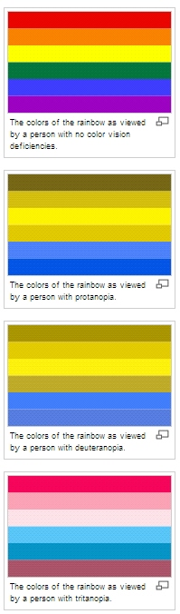
Inherited Color Blindness
Monochromacy: total color blindness, very rare.
Dichromacy:
  One of the three basic color mechanisms is absent or not functioning. It is hereditary and sex-linked, affecting mostly males.
    Protanopia: No red cones. Red appears dark; affects red-green hue discrimination.
    Deuteranopia: No green cones. Affects red-green hue discrimination.
    Tritanopia: Very rare. No blue cones. Affects yellow-blue discrimination.
Anomalous Trichromacy: More common.
One of the cone pigments is altered in its
spectrum. Impairment, but not full loss.
RG
RG
YB
Most RG
Some YB

Slide 21
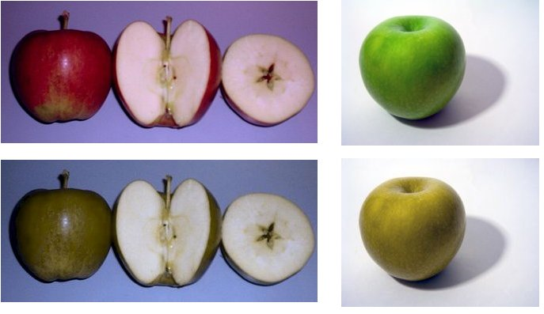
Color Blindness – color vision
Typical Color Vision
Deuteranopia
Notes:
From http://en.wikipedia.org/wiki/Color_blindness
Deuteranomaly (most common - 6% of males, 0.4% of females):[12] Having a mutated form of the medium-wavelength pigment. The medium-wavelength pigment is shifted towards the red end of the spectrum resulting in a reduction in sensitivity to the green area of the spectrum. Unlike protanomaly the intensity of colors is unchanged. This is the most common form of color blindness, making up about 6% of the male population. The deuteranomalous person is considered "green weak". For example, in the evening, dark green cars appear to be black to Deuteranomalous people. Similar to the protanomates, deuteranomates are poor at discriminating small differences in hues in the red, orange, yellow, green region of the spectrum. They make errors in the naming of hues in this region because the hues appear somewhat shifted towards red. One very important difference between deuteranomalous individuals and protanomalous individuals is deuteranomalous individuals do not have the loss of "brightness" problem.

Slide 22
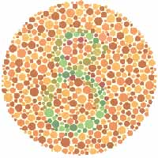
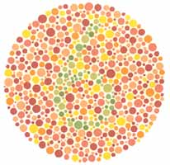
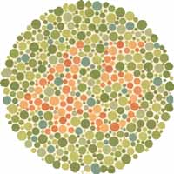
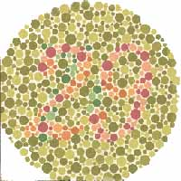
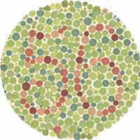
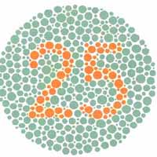
Ishara Dot Tests

Slide 23
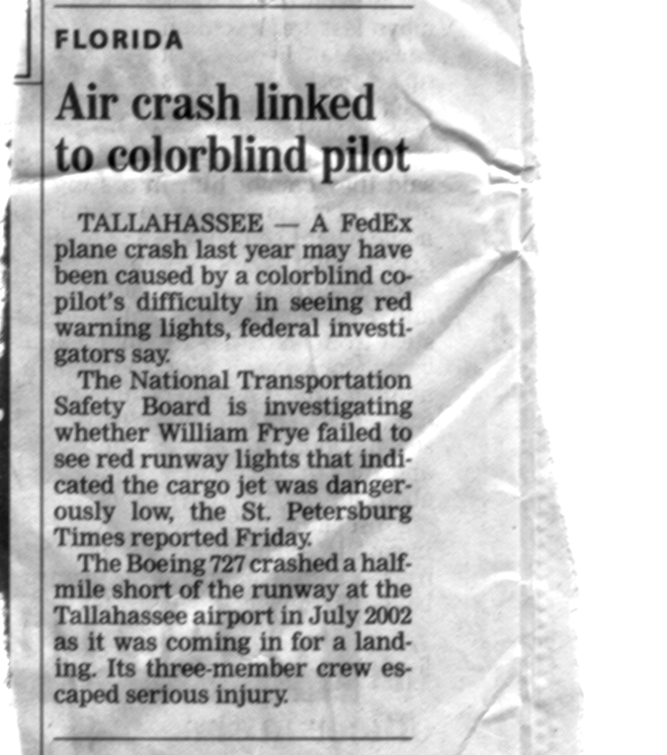
Colorblind pilot
Considering the user’s abilities is important.
Notes:
Considering the user’s abilities is important.

Slide 24
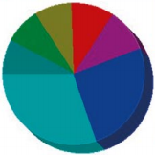
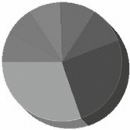
Color Blindness – Applied (Grayscale)
Look at your layout in grayscale. If you can’t see intended differences, chance are neither can color blind individuals

Slide 25
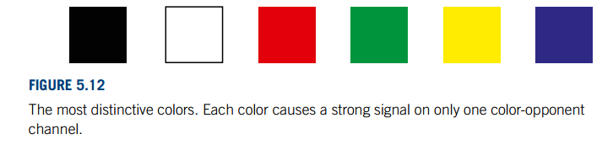
Color Blindness - Applied
Use distinctive colors

Slide 26
Outline - Hearing
Senses
  Vision
  Hearing
  Touch
  Smell
Motor System
Cognitive Abilities
Notes:
LAST SLIDE MAY 4 2015

Slide 27
Hearing 101

Slide 28
Audition (Hearing)
Provides information about environment:
distances, directions, objects etc.
Physical apparatus:
  pinnea – collects sound (part of the ear you can see)
  outer ear – protects inner and amplifies sound
  middle ear – transmits sound waves as
  vibrations to inner ear
  inner ear – chemical transmitters are released
  and cause impulses in auditory nerve
Sound
  pitch – sound frequency
  loudness – amplitude
  timbre – type or quality
  location – where is the sound coming from?

Slide 29
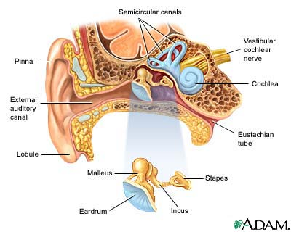
Ear-anatomy

Slide 30
Audition
Capabilities (best-case scenario)
  pitch - frequency (20 - 15,000 Hz)
  loudness - amplitude (30 - 100dB)
  location (5° source & stream separation)
  timbre - type of sound (lots of instruments)
Often take for granted what it indicates
about computer state (disk whirring)
Auditory system filters sounds
  can attend to sounds over background noise.
  for example, the cocktail party phenomenon.

Slide 31
Hearing Impairment

Slide 32
Definitions
Hearing loss: person’s sensitivity to sound intensity and sound frequency
  Sound intensity (loudness) is measured by units known as decibels
  Sound frequency (pitch) is measured using hertz units
Deafness and hard of hearing
  Deaf (loss of 90 db or greater)- profound or total loss of auditory sensitivity and little if any auditory perception
    The primary information input is through vision
  Hard of hearing - partial hearing
    Residual hearing (with amplification) that is sufficient to process language
  These are medical definitions
    We’ll see more important cultural definitions later!

Slide 33
Classifications (1)
When?
  A prelingual loss – before age 2 or before speech development
    Difficulty learning a first language if not provided adequate exposure to a visual sign language or sufficient corrective measures to allow them to learn spoken language.
    Standardized testing has shown that deaf high school graduates in the U.S. have lower than average levels of English literacy skills (median reading level is 4th grade), likely due to reduced exposure to English through childhood and other complex education factors.
  A postlingual loss - any age following speech development

Slide 34
Classifications (2)
Where?
  Peripheral hearing losses
    Conductive hearing losses: poor conduction of sound along passages
    Sensorineural hearing losses: sense organ or auditory nerve
    Mixed hearing: combination of conductive and sensorineural problems
  Central auditory disorder: disorder of symbolic processes
    Auditory perception and discrimination, sound comprehension
What tone?
  What frequencies are lost?
  High tones or low tones or both?

Slide 35
Deafness: Prevalence
Estimates of hearing loss in the United States
  This is a very difficult thing to count – especially if you want to find out who calls themselves deaf, hard-of-hearing, etc.
  Hearing loss: 28 million people, or 1% of the total population
    Other estimates: 1 million are deaf and 11 million have significant and irreversible hearing loss
    Only 5% of people with hearing loss are under the age of 17
    43% are over the age 65
    Men are more likely to experience hearing loss
    Hearing loss decreases as family income and education increase
  71,964 of the students who receive specialized services in public schools have hearing impairments

Slide 36
Terminology
Deaf: refers to cultural affiliation/identity, typically users of ASL
  American Sign Language (ASL) is a distinct language from English, with its own grammar, word-order, and vocabulary.
  There is a community of users of ASL, who often feel a strong cultural connection, have many common life experiences, relate to a common history, and may share cultural beliefs & norms.
deaf: refers to a level of hearing ability, not necessarily cultural
hard-of-hearing: descriptive term preferred by some people with hearing loss who tend to use speech-reading and speaking skills, and who typically do not identify as part of Deaf Culture
People use these terms differently when describing themselves: it is best to ask what term they prefer. These users may want different things from technology… Some preferring English, some preferring ASL, some will not identify as having a disability, etc.

Slide 37
Aging Related Hearing Loss
Different experience than with other forms of deafness; some have difficulty with:
  Acceptance and identification of the condition.
  Adaptation to the condition.
  Reliance on hearing aid technologies and other adaptations (higher volume, etc.)
  Social isolation.
  Lack of awareness of surrounding activity.
Less likely to join Deaf community/culture.

Slide 38
Outline
Senses
  Vision
  Hearing
  Touch
  Smell
Motor System
Cognitive Abilities
Notes:
LAST SLIDE MAY 4 2015

Slide 39
Touch 101

Slide 40
Tactile System
Nerves under the skin's surface that send information to the brain
Information includes light touch, pain, temperature, and pressure
Important role in perceiving the environment as well as protective reactions for survival.
Notes:
web.mnstate.edu/anderkev/SensoryImpairments.ppt

Slide 41
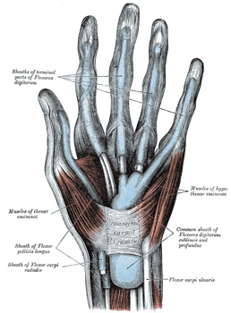
Touch: Tactile/Haptic
Provides important feedback about environment.
May be key sense for someone who is visually impaired.
Some areas more sensitive, e.g. fingers.
Where is this important?
  Mobile devices, mouse, keyboards
  Beepers that vibrate.
  The feedback from buttons or switches
  clicking into place is a way in which the
  tactile sense is used.
  Force-feedback mouse.

Slide 42
Tactile Disorders
Dysfunctional tactile system may lead to a misperception of touch and/or pain (hyper- or hyposensitive)
Loss of spatial or pressure resolution can be the result of injury, skin conditions, or other neurological disorders. This can affect the use of fine-motor user-interfaces or small buttons, etc.

Slide 43
Outline - Smell
Senses
  Vision
  Hearing
  Touch
  Smell
Motor System
Cognitive Abilities
Notes:
LAST SLIDE MAY 4 2015

Slide 44
Smell 101
Not commonly used
in user-interfaces…

Slide 45
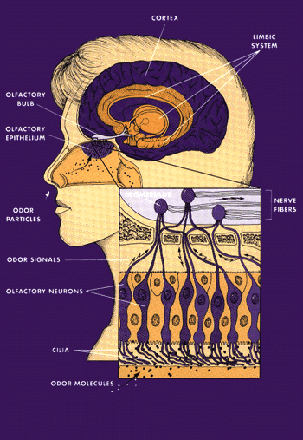
Olfactory System
Receptors are in the olfactory lining of the nasal passages.
  Sensory nerve cells, or neurons, with hairlike fibers called cilia on one end.
The brain organizes information from these receptors into patterns interpreted as different odors.
Examples of use: Methylmercaptan added to natural gas to give a distinctive odor, to detect leaks.
Older adults often lose their sense of smell with time.
Notes:
web.mnstate.edu/anderkev/SensoryImpairments.ppt

Slide 46
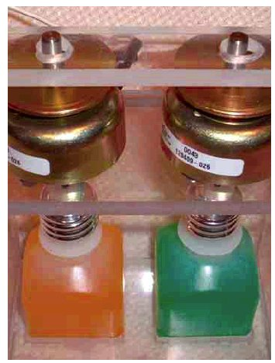
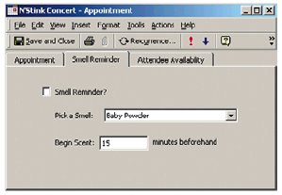
Smell
Some researchers are studying how to
use smell as an output channel for
computer systems!
Joseph Kaye, “Making scents: aromatic output for HCI” ACM Interactions Volume 10, Number 1 (2004), Pages 48-61
Solenoid-controlled scent bottles

Slide 47
Outline – Disability Simulators
Senses
  Vision
  Hearing
  Touch
  Smell
Motor System
Cognitive Abilities
Notes:
LAST SLIDE MAY 4 2015

Slide 48
Extra Slides
Disability Simulators

Slide 49
Simulators
Visual Impairment Simulator for Windows (NOTE: that this does not seem compatible with Win10) http://vis.cita.uiuc.edu/
Distractibility Simulation http://webaim.org/simulations/distractability
Dyslexia Simulation http://webaim.org/simulations/dyslexia
Online visual impairment simulator http://webaim.org/simulations/lowvision
Simulator for color blindness http://www.iamcal.com/toys/colors/

