Slide 1
Web Accessibility

Slide 2
Benefits of the Web
Blind users who are able to read the newspaper posted online using a screen reader.
  Braille and tape versions impractical.
People with motor disabilities who could not pick up a newspaper or turn its pages can read it online via assistive technology.
People who are deaf can get more immediate captioned or text-based news content that you used to have to rely on TV or radio to get.
People with cognitive impairments may benefit from the flexible way the information can be presented.
Notes:
LAST SLIDE 2015 MAY 6`

Slide 3
Falling Short of Expectations
Some web pages require a mouse in order to be navigated.
Some pages have video/audio content that is not captioned.
Some web pages have much of their content presented as graphics only – what can a screen reader get access to?

Slide 4
Web Accessibility Principles
Web accessibility principles for users who are blind:
Make pages perceivable: because they cannot perceive (see) visual information such as graphics, layout, or color-based cues
Make pages operable: because they usually depend on a keyboard to operate (navigate) web content functionality, rather than a mouse
Make pages understandable: because they cannot understand content that is presented in an illogical linear order, or which contains extraneous text not meant to be read word for word or character by character (such as long Web addresses), etc.
Make pages robust: because the assistive technologies used by the blind are not always capable of accessing a broad range of technologies, especially if they are new.

Slide 5
Basics
Webpages = text file written in HTML language
  Sometimes you need to look at the contents of the HTML file itself in order to do an evaluation of the accessibility of the website.
<html>
<body>
<p>You are <b>learning</b>HTML</p>
<p>Here is a photo <img src="smileyface.jpg" alt="Smiley face" /> </p>.
<p>This is a <a href=“http://www.google.com/”>link to google</a>.</p>.
</body>
</html>
You are learning HTML
Here is a photo ☺.
This is a link to google.

Slide 6
Accessible Web Design Approaches - Alternate Text
Alternate Text
Table Headings
Forms
Meaningful Link Text
Captions and Transcripts
Other File Formats
Using Headings for Semantic Structure
Keyboard & Navigation
Never Rely on Color-Coding Only
Readability Level of Text
Cognitive Disabilities
Conforming to Standards
Site Maps, Site Search

Slide 7

Details of “alt” attribute
Screen readers can't describe images; they rely on there being some text in the document that serves as an alternative.
  This is called the "alt" text for an image.
  If you are using an editing tool, then you might need to look in some “Properties” of the image you added.

Slide 8


What is good "alt" text?
Good "alt" text conveys purpose or function of the image; appearance is less critical.
  Same picture on different pages
    Family site: "Picture of my aunt Sally."
    Museum: "Oil-painting entitled Sally by
    Moonlight by Robert Caldwell in 1856."
  Alt text should be as succinct as possible.
  If decorative picture (no info content), then let alt="" The screen reader will pass it silently.
  If clickable image (especially one with multiple different clickable regions), need alt text for each.

Slide 9

Other alt-text issues
Pictures of Words
  Must set "alt" text as the same words as picture
Background Images (shouldn't be important info)
  No “alt” text is read for the background image.
Graphs and charts.
  Summarize the content of each graph and chart
  Perhaps provide a link for full data description
Videos
  Need a description of the main visible action if not clear from the audio portion.

Slide 10
Accessible Web Design Approaches – Table Headings
Alternate Text
Table Headings
Forms
Meaningful Link Text
Captions and Transcripts
Other File Formats
Using Headings for Semantic Structure
Keyboard & Navigation
Never Rely on Color-Coding Only
Readability Level of Text
Cognitive Disabilities
Conforming to Standards
Site Maps, Site Search

Slide 11
Headings for Tables
Reading aloud left-to-right top-to-bottom, data tables can be confusing.
If 20 columns and 20 rows, how are you supposed to remember the order of all the columns?
Good webpages label the top cell in each column (and/or left cell per row) as a "Table Header" cell.
  In the HTML, this looks like a <th> (table header cell) instead of a <td> (table data cell). Some people forget.
  If you do this, the screen reader users can better navigate the data table; they can press a button to ask the screen reader to remind them of the heading for the row and column of the cell that is being read.

Slide 12
Accessible Web Design Approaches - Forms
Alternate Text
Table Headings
Forms
Meaningful Link Text
Captions and Transcripts
Other File Formats
Using Headings for Semantic Structure
Keyboard & Navigation
Never Rely on Color-Coding Only
Readability Level of Text
Cognitive Disabilities
Conforming to Standards
Site Maps, Site Search

Slide 13
Forms
Ensure users can complete and submit all forms.
Ensure that every form element (text field, checkbox, dropdown list, etc.) has a label and make sure that label is associated to the correct form element using the <label> tag.
Also make sure the user can submit the form and recover from any errors, such as the failure to fill in all required fields.
http://www.webaim.org/techniques/forms
http://www.webaim.org/techniques/formvalidation/

Slide 14
Accessible Web Design Approaches - Meaningful Link Text
Alternate Text
Table Headings
Forms
Meaningful Link Text
Captions and Transcripts
Other File Formats
Using Headings for Semantic Structure
Keyboard & Navigation
Never Rely on Color-Coding Only
Readability Level of Text
Cognitive Disabilities
Conforming to Standards
Site Maps, Site Search

Slide 15
Meaningful Link Text
Screen reader users skim a page to get a sense of its structure by jumping from link to link.
  There's a keyboard button for this, TAB.
  Every link should make sense if the underlined link text is read by itself.
  Certain phrases like "click here" and "more" must be avoided. Or that will be all that the screen reader user will hear when "tabbing" through the webpage.

Slide 16
Accessible Web Design Approaches -Captions and Transcripts
Alternate Text
Table Headings
Forms
Meaningful Link Text
Captions and Transcripts
Other File Formats
Using Headings for Semantic Structure
Keyboard & Navigation
Never Rely on Color-Coding Only
Readability Level of Text
Cognitive Disabilities
Conforming to Standards
Site Maps, Site Search

Slide 17
Captions for Deaf Users
Avoid websites with heavy sound/voice use.
  Or it should be redundant with information presented visually through text, sign language, or pictures.
Deaf users rely on videos, animations, and audio on websites to be captioned. (This helps others, too.)
  Captions are more than just "subtitles" in a foreign language film. They include: who is speaking, vocal emotion/stress, sound effects, background noises, key musical cues, and information about where to place the text boxes on the screen (near speaker, avoid stuff).
  Professionally prepared for TV shows, sports events
  Can be done "live" for events or in a classroom (CART).
http://www.webaim.org/techniques/captions/

Slide 18
Deafness and Literacy
Only half of deaf high school graduates (age 18+) can read English at a fourth-grade (age 10) level.
  Various language development and educational reasons
  American Sign Language ≠ Signs in English word order
  Understanding complex concepts in English may be a challenge, especially spatial topics.
  Videos or animations of ASL interpreting can be better than captions for complex or high-speed information.
Key idea: Just because there are letters displayed visually on a screen, this isn't a guarantee that the information is accessible for deaf website users.

Slide 19
Accessible Web Design Approaches - Other File Formats
Alternate Text
Table Headings
Forms
Meaningful Link Text
Captions and Transcripts
Other File Formats
Using Headings for Semantic Structure
Keyboard & Navigation
Never Rely on Color-Coding Only
Readability Level of Text
Cognitive Disabilities
Conforming to Standards
Site Maps, Site Search

Slide 20
Other File Formats
Ensure accessibility of non-HTML content, including PDF files, Microsoft Word documents, PowerPoint presentations and Adobe Flash content.
In addition to all of the other principles listed here, PDF documents and other non-HTML content must be as accessible as possible.
  If you cannot make it accessible, consider using HTML instead or, at the very least, provide an accessible alternative.
  PDF documents should also include a series of tags to make it more accessible. A tagged PDF file looks the same, but it is almost always more accessible to a person using a screen reader.

Slide 21
Accessible Web Design Approaches - Using Headings for Semantic Structure
Alternate Text
Table Headings
Forms
Meaningful Link Text
Captions and Transcripts
Other File Formats
Using Headings for Semantic Structure
Keyboard & Navigation
Never Rely on Color-Coding Only
Readability Level of Text
Cognitive Disabilities
Conforming to Standards
Site Maps, Site Search

Slide 22
Headings as Semantic Structure
You can put codes in the file to indicate that some words are "headings" <H1> or "subheadings" <H2>
    Some authors just set font/style attributes of some of the text to make it look like a heading without using these.
    It is more accessible if you use these tags in the page.
Blind people using screen readers can't skim the entirety of a Web page as a sighted user can.
Blind users like to navigate Web pages by structure
  Jump directly to top level elements (<h1>), next level elements (<h2>), third level (<h3>), etc.

Slide 23
Checking Semantic Headings
See the structure of one of your Web pages by accessing http://validator.w3.org/detailed.html.
  Enter the Web page URL into the text box, check the Show Outline checkbox, and press Validate this page.
  For now, ignore any HTML errors that are shown and go to the bottom of the page to see the page's outline.
  You will see an outline of the content structure of your Web page as defined by headers tags (<h1> - <h6>).
  If the output does not look like a real outline, it is likely that the heading tags are not being used properly (or that there are not any heading tags).
See also: http://www.w3.org/2003/12/semantic-extractor.html

Slide 24
Accessible Web Design Approaches -Keyboard & Navigation
Alternate Text
Table Headings
Forms
Meaningful Link Text
Captions and Transcripts
Other File Formats
Using Headings for Semantic Structure
Keyboard & Navigation
Never Rely on Color-Coding Only
Readability Level of Text
Cognitive Disabilities
Conforming to Standards
Site Maps, Site Search

Slide 25
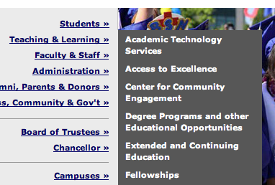

Keyboard-Only Users
Screen reader users use their keyboard as their primary means of navigating the computer.
Many people with motor disabilities also use input devices that simulate keyboard-only, not mouse.
Elements of a webpage that depend on clicking or movement of the mouse will be problematic.
  Menus which require you to aim
  your mouse on top of them before
  the options appear.
  Animated/moving elements on the
  screen which someone must click.
  "Flash" animated elements on a
  webpage that aren't set up to
  allow keyboard button interaction.

Slide 26
Event Handlers
To ensure accessibility, use either a device-independent event handler (one that works with both the mouse and the keyboard) or use both mouse-dependent and keyboard-dependent handlers.
E.g., onMouseOver is only triggered for users of a mouse
Combine onMouseOver and onFocus

Slide 27
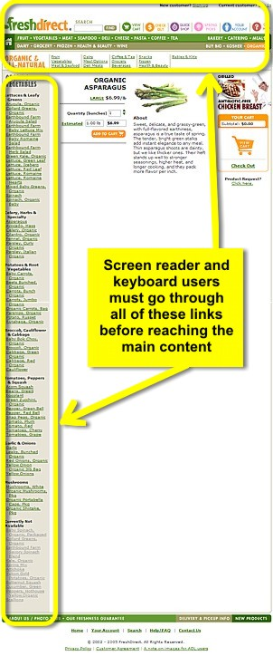
Skip Navigation Links
Good pages allow users to skip menus or other elements that repeat on every page.
  This is usually accomplished by providing a "Skip to Content," "Skip to Main Content," or "Skip Navigation" link at the top of the page which jumps to the main content of the page.
  Sometimes you can't see this link on the page (they'll make the font color the same as the background or hide it in some way), but it is still read by a screen reader so user can click it.
http://www.webaim.org/techniques/skipnav/

Slide 28
Accessible Web Design Approaches - Never Rely on Color-Coding Only
Alternate Text
Table Headings
Forms
Meaningful Link Text
Captions and Transcripts
Other File Formats
Using Headings for Semantic Structure
Keyboard & Navigation
Never Rely on Color-Coding Only
Readability Level of Text
Cognitive Disabilities
Conforming to Standards
Site Maps, Site Search

Slide 29
Never Rely on Color-Coding
Don’t rely on color alone to convey meaning.
The use of color can enhance comprehension, but do not use color alone to convey information.
That information may not be available to a person who is colorblind and will be unavailable to screen reader users.
http://www.webaim.org/articles/visual/colorblind.php

Slide 30
Accessible Web Design Approaches - Readability Level of Text
Alternate Text
Table Headings
Forms
Meaningful Link Text
Captions and Transcripts
Other File Formats
Using Headings for Semantic Structure
Keyboard & Navigation
Never Rely on Color-Coding Only
Readability Level of Text
Cognitive Disabilities
Conforming to Standards
Site Maps, Site Search

Slide 31
Reading Level of Text
Keep the complexity level of the text on your website as simple as possible.
  Be careful of non-literal text like sarcasm, or texts in which someone needs to “read between the lines” or make lots of inferences.
There are online tools for scoring a text's difficulty level (or grade level).
More people will be able to use the website.
http://www.webaim.org/techniques/writing/

Slide 32
Design Impact: Text Comprehension
As a general statement, the more structured your document is, the easier it will be to understand. Structure in documents can be created by adding:
  headings
  bulleted lists
  numbered lists
  definition lists
  indented quotes (using the <blockquote> tag)
Use of whitespace can also convey structure.
Notes:
Webaim

Slide 33
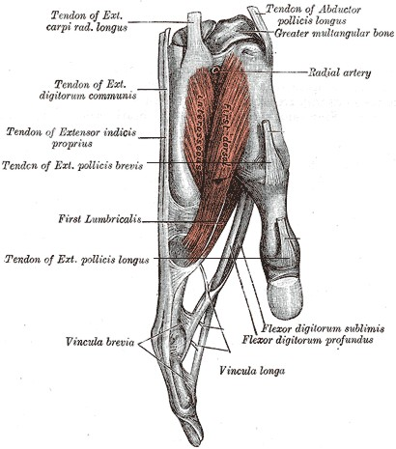
Worth a Thousand Words
Imagine trying to convey this complex anatomical structure to using words alone.
Supplemental media such as illustrations, icons, video and audio have the potential to greatly enhance the accessibility of web content for people with cognitive disabilities.

Slide 34
Accessible Web Design Approaches - Cognitive Disabilities
Alternate Text
Table Headings
Forms
Meaningful Link Text
Captions and Transcripts
Other File Formats
Using Headings for Semantic Structure
Keyboard & Navigation
Never Rely on Color-Coding Only
Readability Level of Text
Cognitive Disabilities
Conforming to Standards
Site Maps, Site Search

Slide 35
Design Impact: Memory
Any kind of reminder of the overall context of a web site can help people with memory deficits.
Lengthy interactive processes, such as those required to purchase items online, should be kept as simple and brief as possible.
To focus the users' attention on specific tasks, the interaction should probably be broken up into separate pages, but help users keep track of their progress so they do not get lost in the process.
Notes:
Webaim

Slide 36
Design Impact: Problem Solving
Resilience can be low for errors and the resulting frustration may make someone abandon a computer program or website.
  404 error from a bad link or a link that does not take them where they thought they were going
Error messages should be as clear as possible, telling users what they did wrong and how to fix the problem.
Search features should suggest alternate spellings to users if the original spelling seems suspicious
Users should be warned when actions can cause potentially serious consequences, such as deleting a file.
Notes:
Webaim

Slide 37
Design Impact: Attention
Distractions such as scrolling text and blinking icons can make the web environment difficult.
Use headings to draw attention to the important points and outline of the content.
Avoid background noises or images that distract.
Notes:
Webaim

Slide 38
Design Impact: Flashing Images
People with seizure disorders can be sensitive to images with flashing or with complex patterns that seem to “jump” or “wiggle” due to optical illusions.
Be careful when you design your animations. Don't cause a seizure!
  Most designers don't create graphics that even approach the point that they might cause seizures, but some multimedia developers do venture into this territory.
  Flash designers are especially notorious for creating modernistic animations that flicker and strobe across the screen.

Slide 39
Cognitive / Learning Disabilities
Flashing images: seizure disorders
Supporting Read-Aloud
  May prefer to have the computer automatically read the text on a website out loud.
Spelling, writing difficulties
  May benefit from spell-checkers, other tools.
Distractions on webpages (advertisements, many links, cluttered structure, decorative animations) may impact comprehension

Slide 40
Accessible Web Design Approaches - Conforming to Standards
Alternate Text
Table Headings
Forms
Meaningful Link Text
Captions and Transcripts
Other File Formats
Using Headings for Semantic Structure
Keyboard & Navigation
Never Rely on Color-Coding Only
Readability Level of Text
Cognitive Disabilities
Conforming to Standards
Site Maps, Site Search

Slide 41
Conforming to Standards
Making sure that your website follows the official HTML format will make it more likely that users with disabilities will be able to access your site, because their tools will interact with it in expected ways.
For instance, it is recommended to follow the modern standard of separating the specification of your content from its visual appearance…

Slide 42
Several ways to control appearance
There are several ways in which someone can set the visual appearance (size, color, boldness, font, placement, borders, etc.) of items on a webpage.
  Some ways of doing this are "hard coded" such that things don't resize or change appearance, even if the user asks their webbrowser to enlarge the page or override the colors.
  This makes the page less accessible for low vision users who many need this flexibility.

Slide 43
Using CSS for Visual Details
Using "Cascading Style Sheets" (CSS) is the preferred way to set visual details.
  This allows the author of a webpage to separate the information content of a page from the details of its visual presentation.
  This makes it easy for the author to set the order in which elements of the webpage should be read by a screen reader, regardless of how they are laid out visually on the screen.
  This provides more flexibility and accessibility.

Slide 44
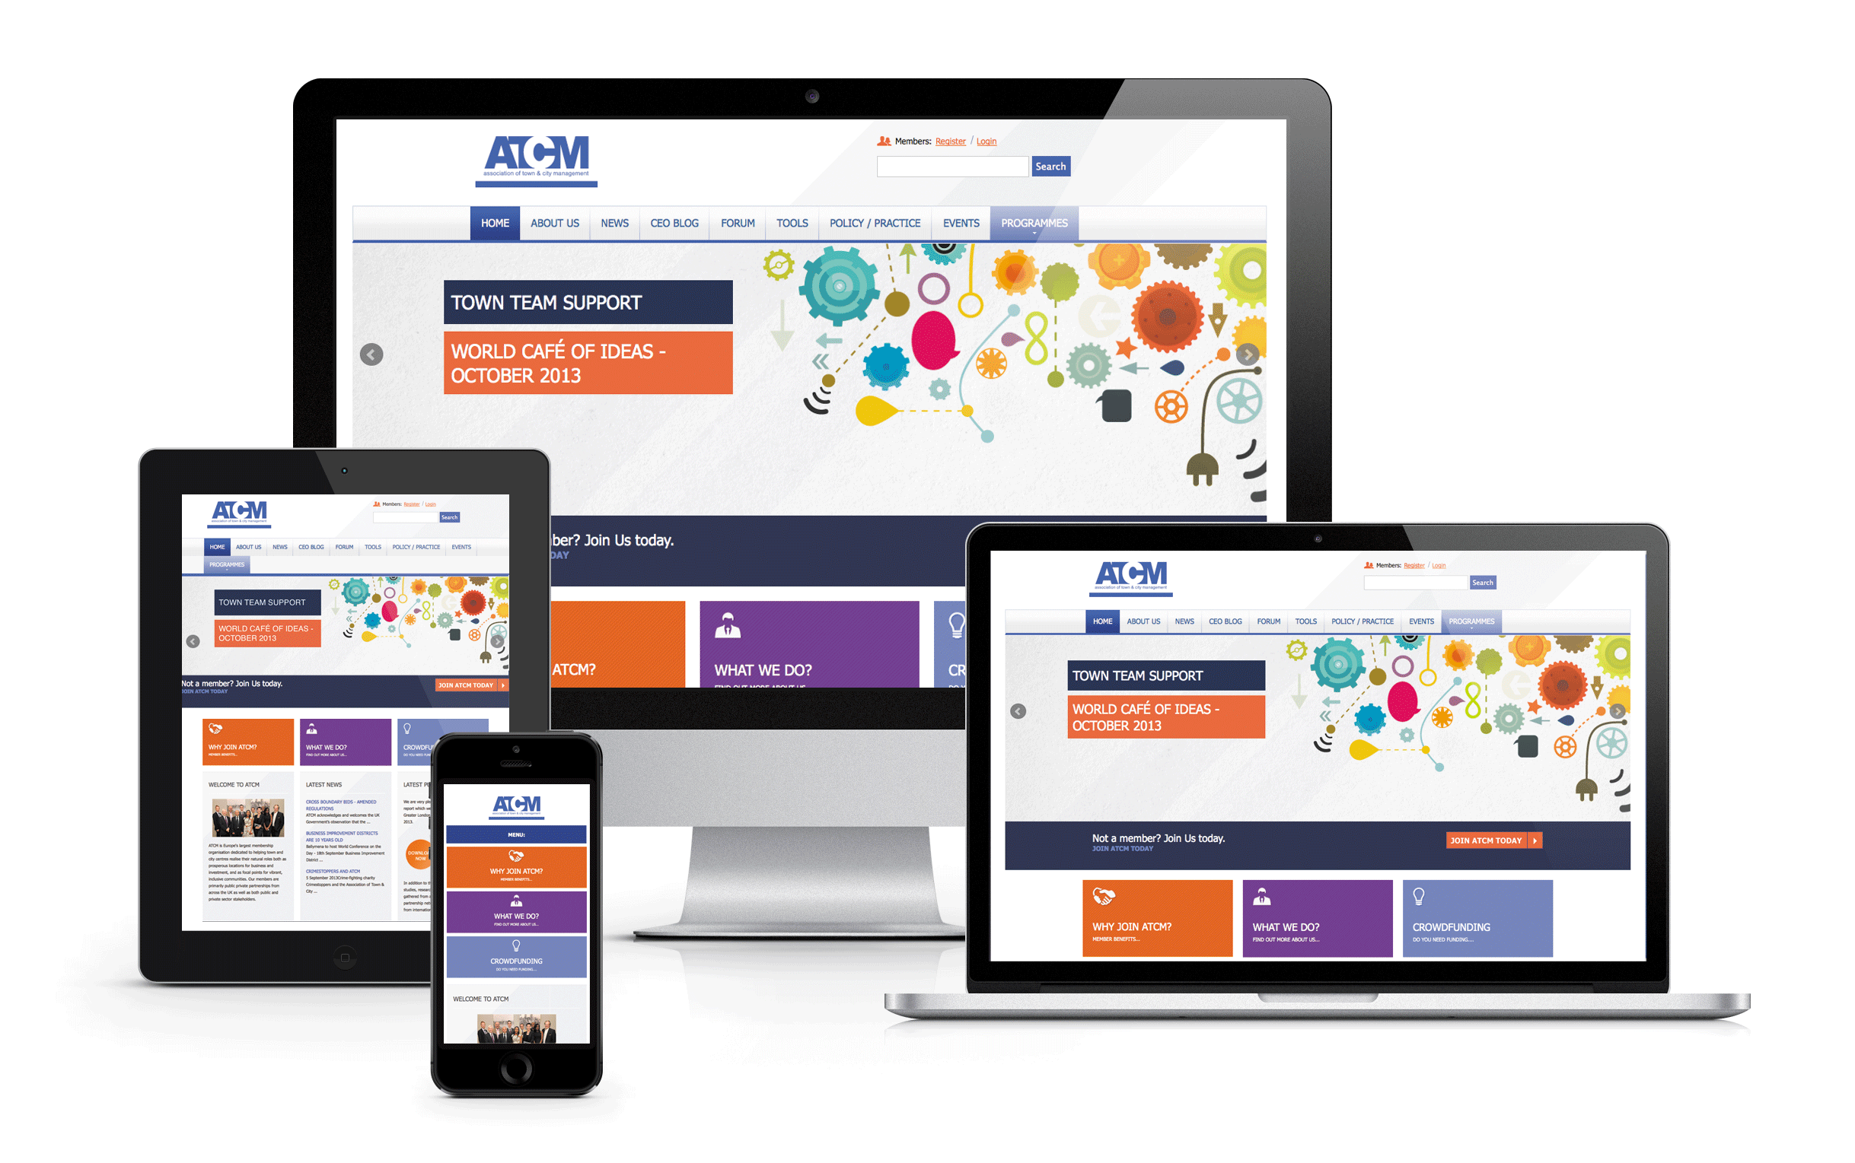
Responsive Design
Website design in which the presentation of pages adapts to the specific device or screen size of the user can benefit people with disabilities.
RD can help the user
of a smartphone avoid
“sideways scrolling”
to read lines of text,
and it also benefits
people who use
screen magnifiers.

Slide 45
Don’t Use Tables to Layout Page
Tables should not be used to layout a web page!
Older sites use tables for page layout
New standard frown upon this practice
Primary reason: Accessibility
Layout in HTML and CSS

Slide 46
Accessible Web Design Approaches - Site Maps, Site Search
Alternate Text
Table Headings
Forms
Meaningful Link Text
Captions and Transcripts
Other File Formats
Using Headings for Semantic Structure
Keyboard & Navigation
Never Rely on Color-Coding Only
Readability Level of Text
Cognitive Disabilities
Conforming to Standards
Site Maps, Site Search

Slide 47
Site Searches, Site Maps
For users of screen readers who may have a hard time browsing through your site to quickly identify topics of interest, a well-designed site map or search feature can save a lot of time and effort.
  The FORM interface to the search must be accessible.
  Results page should be structured so that it is easy to browse (and skip forward through) using a screen reader.
Users with cognitive disabilities may also benefit from being able to locate relevant information.
Users with learning disabilities (e.g. dyslexia) would benefit from a search tool with a built-in spellcheck.

Slide 48
Text only versions
Generally, producing a duplicate version of your website without any pictures is not helpful for users with disabilities.
Will your organization keep the text-only version up-to-date? Does it do all the same functions as the main website?
A well-designed website that is screen-reader compatible is fine. The screen reader will do most of the work of producing the text version of the page for a blind user – as long as the page is well designed.

Slide 49
Accessible Web Design Approaches
Alternate Text
Table Headings
Forms
Meaningful Link Text
Captions and Transcripts
Other File Formats
Using Headings for Semantic Structure
Keyboard & Navigation
Never Rely on Color-Coding Only
Readability Level of Text
Cognitive Disabilities
Conforming to Standards
Site Maps, Site Search

Slide 50
EXTRA SLIDES
Step by Step: Evaluating the Accessibility
of a Website

Slide 51
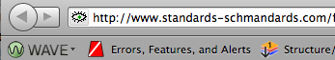
Accessibility Auto-Checking Tools
Free "WAVE" tool: wave.webaim.org
  Website will analyze other webpages for you, adding icons to a version of the page that represent structural, content, and accessibility features or problems.
  It also has a toolbar
  you can add to your
  webbrowser for quick access to features.
  It can also turn off images and styles/formatting on your page to help you see if it would be screen-reader friendly.
Notes:
“WebAccessibility” for Chrome

Slide 52
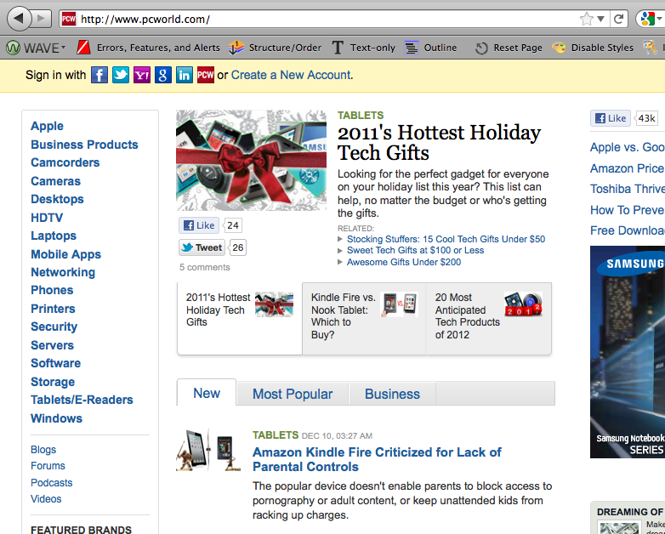
Website screenshot on which the WAVE tool will be used

Slide 53
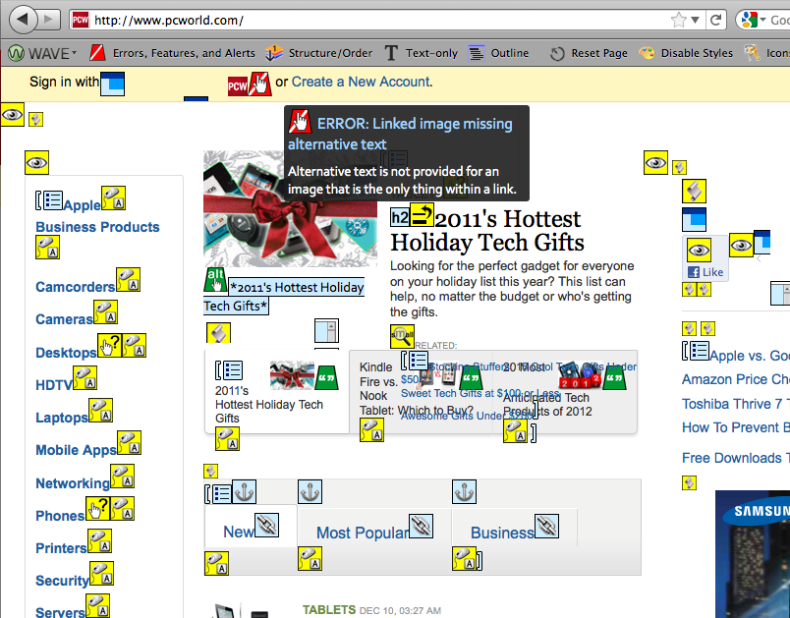
Webpage with WAVE tool results

Slide 54
FANGS Screen Reader Simulator
FANGS is a plug-in you can install on your Firefox web-browser that will present a script of what a screen-reader would say aloud to a blind person viewing the page.
  Does the webpage text still make sense without images? Do all the images have good "alt" tags?
      Is the page understandable without being able to visually scan it (to figure out its organization)? Imagine if you couldn't visually skip ahead with you eyes and had to listen to all of this. Would you "get it"?
It can also show you a list of all the headings and links on the page (how a blind user would scan).
FANGS: https://addons.mozilla.org/en-us/firefox/addon/fangs-screen-reader-emulator/
Or try ChromeVox: https://chrome.google.com/webstore/detail/kgejglhpjiefppelpmljglcjbhoiplfn

Slide 55
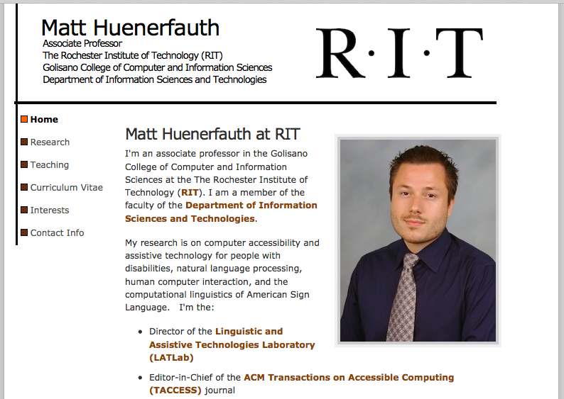
Website on which the FANGS tool will be run

Slide 56
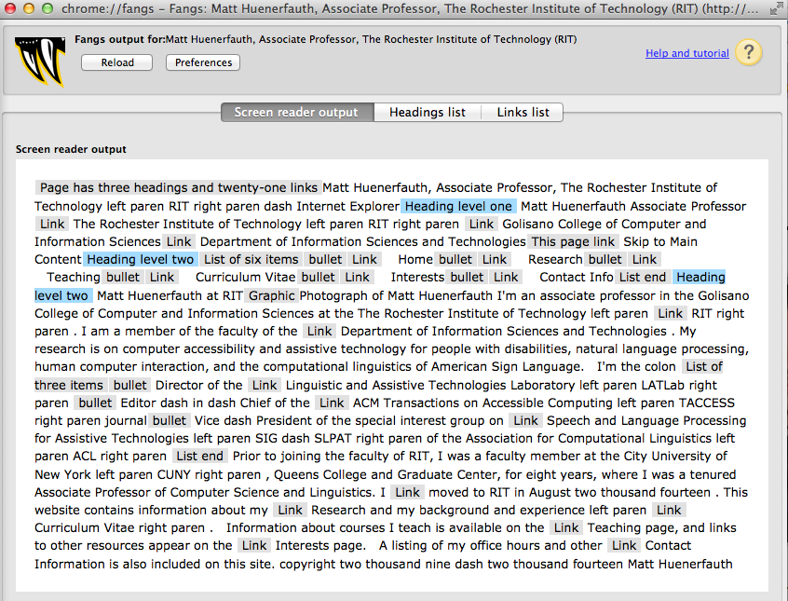
Results of FANGS

Slide 57
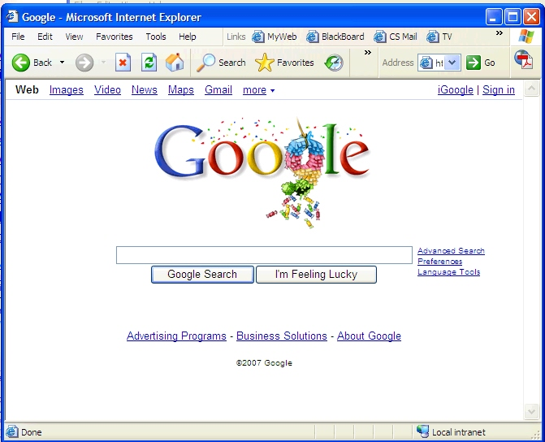
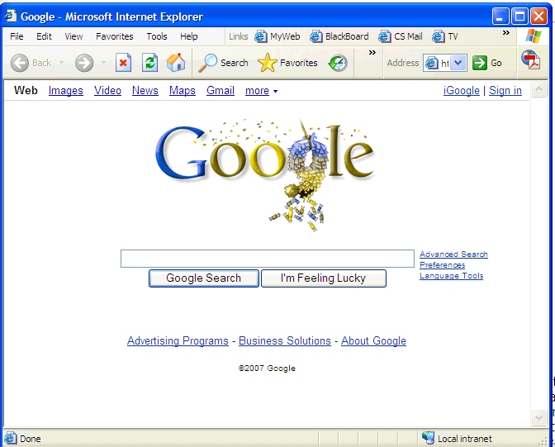
VisCheck
Vischeck shows what a web page or image looks like to a person who is colorblind.
http://www.vischeck.com/

Slide 58
Other things to try
Use a screen reader yourself: JAWS (free for 45 minutes), VoiceOver (built-in to Macs).
Enlarge the page, a lot. Like a "Screen Magnifier"
  Does the page have a fluid layout that minimizes horizontal scrolling? Does the text look pixelated?
Turn down your monitor's contrast and color saturation (murky, blurry, black & white).
Jump around the page using only your keyboard.
  Can you use the "TAB" key to jump to all the links? In a logical order? Do some menus only appear if you use a mouse? Can you get to all the text input boxes?
Ask expert or someone with a disability to check.
Notes:
LAST SLIDE

Slide 59
User Testing
If possible, get actual feedback from individuals with disabilities.
Sometimes features of the site that you believed would increase accessibility end up being very confusing or inaccessible.
Be willing to make changes based on user testing.
Especially seek feedback on your navigation structure and use of language.
  These two things can pose huge accessibility barriers to a large group of individuals.
  As soon as their recommendations for changes have been made, have them test again and see if things are better. Encourage feedback from all of your site visitors.

Slide 60
EXTRA SLIDES
Tools for Making Content Accessible

Slide 61
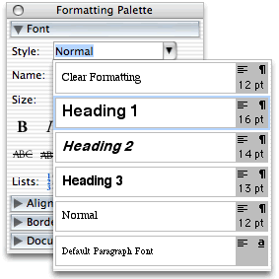

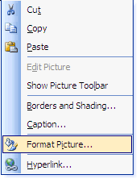
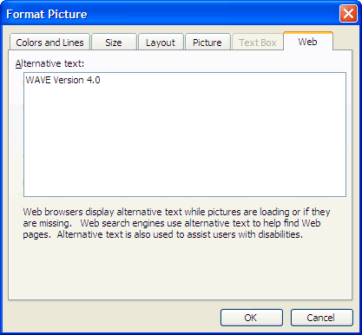
Make the Content Accessible in Word
Copy/paste the information from a webpage into Microsoft Word, add headings to the sections of the page (use the built-in "Heading 1,"
"Heading 2," Heading 3" styles).
Pictures without alt text?
Write an explanation
  Add it to the document
  Or use "Format Picture"
  to actually add "alt text"
  to the picture.
Save as a webpage.

Slide 62
Making PDFs accessible
PDFs retain the appearance of a document on various platforms. However, if not built correctly, they are inaccessible for screen reader users.
  Any simple text-and-graphic document that is typeset in a single column should be provided as an ordinary web page.
  At worst, the PDF file might just be a big image file of the page of text!

Slide 63
Accessible PDFs
In general, “print to PDF” is bad. This makes an image of a page as a PDF, and the screen reader can’t read it.
Use a special export or save-as command.
Make sure the document has a logical reading order defined if you have lots of little text boxes floating on the page.
Use the built-in style names like “Heading 1”
Embed fonts, avoid complicated tables, etc.

Slide 64
Visual Descriptions for Videos, too
Movies, demonstration videos, or animations can be made accessible to blind students by creating a description of what happens visually in them.
  Many modern movies are available on DVD with a second audio track that you can enable with visual descriptions for blind audiences.
  You can record your own audio to play at the same time.
  You can write a text description of what happens.

Slide 65
Captioning / Interpreting
There are professional services you can hire to do high-quality captioning for you for deaf audience.
  They will give you a file with time-codes and text for any video you provide them.
  There’s a standard file format for captions. It also includes where on the screen the text should appear.
  Then, you can use standard video editing software to add the text to your video.
You could also hire a professional sign language interpreter to translate some information content and videorecord them doing this.

Slide 66
(Semi)Automatic Captioning
YouTube has new auto-captioning:
  http://www.youtube.com/watch?v=kTvHIDKLFqc
  It uses text-to-speech technology to detect the words that are said, but the accuracy is VERY POOR!
  For better accuracy, you can give it a text script, and it will automatically time-align this with the video.
Note: these are just subtitles, not captions.
  Emotion, sounds effects, background sounds, musical cues, placement of the captions on the screen to convey speaker and avoid stuff, etc.

Slide 67
Camtasia Studio
Popular video editing program, easy captions
  Like YouTube, it can try to automatically detect the words using text-to-speech or you can give it a transcript (and it will auto-align with the video)

Slide 68
Adjusting Colors
You can add redundant information to a webpage (so it doesn't rely on color-coding)
You can also use photo software to boost the constrast of images for low vision users.
  Or make a new, bold black & white version of it.
You can try to re-color things on a webpage to make it easier for colorblind users to see.
  There is even a tool that tries to do this automatically, called Daltonize.
  http://www.vischeck.com/daltonize/

Slide 69




Colorblind
1. Original
Image
2. How a color-blind person sees image #1.
3. Image modified by the Daltonize software.
4. How a color-blind person sees image #3.

Slide 70
Resources
webaim.org – Center for Persons with Disabilities at Utah State University
WAVE: accessibility checker
http://wave.webaim.org
FANGS: screen-reader simulator
http://www.standards-schmandards.com/projects/fangs/
VisCheck, Daltonize: color blindness tools
http://www.vischeck.com/

Slide 71
Additional Resources
Trace Center - Photosensitive Epilepsy Analysis Tool http://trace.wisc.edu/peat/
VizCheck Color Blindness (incl. baby vision simulator) http://www.vischeck.com/
JAWS evaluation copy
http://www.freedomscientific.com/Downloads/JAWS

Slide 72
More Web Accessibility Resources
http://www.webaim.org/techniques/css/
http://www.webaim.org/techniques/css/invisiblecontent
http://www.webaim.org/techniques/fonts/
http://www.webaim.org/techniques/textlayout/
http://www.webaim.org/techniques/tables/
http://www.webaim.org/techniques/frames/
http://www.webaim.org/techniques/templates/
http://www.webaim.org/techniques/hypertext/
http://www.webaim.org/techniques/screenreader/

Slide 73
Even More Web Resources
WCAG 2.0 Theme Song Web Content Accessibility Guidelines https://youtu.be/gtuna2AWvqk
Web Design Resources http://www.washington.edu/doit/resources-accessible-web-design
Web Resources (tutorials, tech specific info) http://www.washington.edu/doit/accessweb
Accessible Web Design Video (~10 min) http://www.washington.edu/doit/videos/index.php?vid=35
W3C Accessibility Standards http://www.w3.org/standards/webdesign/accessibility#examples

